Slide 1
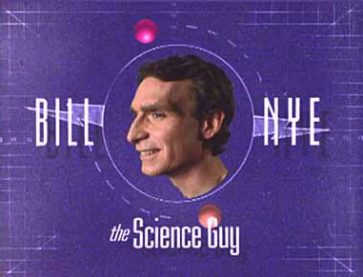
On Evolution…

Slide 2
Did you know?
The average 70 kg adult contains approximately 6.7 x 10²⁷ atoms, 100 trillion cells and is composed of 60 chemical elements

Slide 3
1. What “stuff” do all living things have in common?
- All living things are composed of the same basic molecules, including DNA.
- oxygen, carbon, hydrogen, nitrogen , calcium, phosphorus are the 6 most abundant elements that make up the majority of molecules in the human body.

Slide 4
Deoxyribonucleic Acid (DNA)

Slide 5
2. Are copies always identical? Explain.
- No, copies are not always identical. Small changes are made every time a cell in the body makes a copy of itself. It’s these small changes that are the basis of evolution.

Slide 6
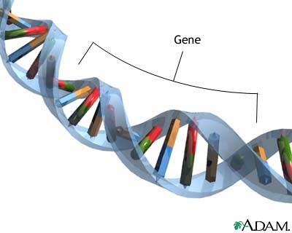
3. What is a gene?
- A gene is a small piece (segment) of the DNA molecule.
- It is the basic unit of heredity (the passing of traits to offspring) in a living organism.
DNA is located inside the cell nucleus

Slide 7
4. If the creation of primordial life on Earth 3 billion years ago was written as an equation, what would be the reactants and products in this equation?
- Reactants: (input into the system)
primordial soup (ocean-H₂O)
ammonia (ancient Earth’s atmosphere)
energy (radiant from sun and electrical from thunderstorms)
- Products: (output)
DNA (building blocks of life)

Slide 8
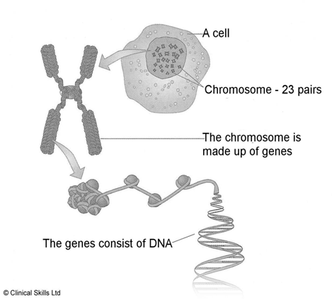
5. How many chromosomes do humans have?
Almost every one of your 100 trillion cells has the same 23 pairs of chromosomes – total 46 (half from mom, half from dad)

Slide 9
6. Why does Bill Nye keep reinforcing the idea of ‘small changes’ when speaking about evolution?
Small changes in the DNA of living organisms (which occurs through genetic mutations when cells make copies of themselves) is the main driving force behind the large changes seen over billions of years of life on Earth. This is evolution!

Slide 10
7. What is paleontology?
Paleontology is the study of prehistoric life of based on the examination of fossil remains of plants and animals.

Slide 11
8. How do paleontologists study evolution?
- Paleontologists study evolution by analyzing fossils.
- Fossils (from Latin fossus, literally "having been dug up") are the preserved remains or traces of animals, plants, and other organisms from the remote past.

Slide 13
9. What is the relationship between the habitat of a species and survival? Describe the experiment shown in the movie which demonstrates this?
- The more diverse the habitats a species can survive in, the better chance it has at surviving.
- Example:
Moss is a plant that can survive nearly anywhere. If you combine moss and milk in a blender, then pour the mixture in cracks in the sidewalk, after a few days the moss will have grown in between the cracks!

Slide 14
10. What is the cause for the disappearance of certain species over time?
- Extinction of a species is gnerally caused by a change in their habitat (environment) such that they can no longer survive there.

Slide 15
11. What is artificial selection?
- Artificial selection is a form of evolution where man, and not nature is the driving force.
- Artificial selection (or selective breeding) describes intentional breeding for certain traits, or combination of traits.
- Ex: genetically modified organisms (GMOs), domestic pets

Slide 16
12. Explain Darwin’s theory of Natural Selection using the Galapagos Finches as an example.
- Charles Darwin’s suggested that all living things on Earth evolved from a common ancestor.
- Example:
Different varieties of finches on the Galapagos islands all came from the same finch but developed different traits (different beaks) in order to be more well adapted to their habitat (different food sources)

Slide 17
The Galapagos Finches

Slide 18
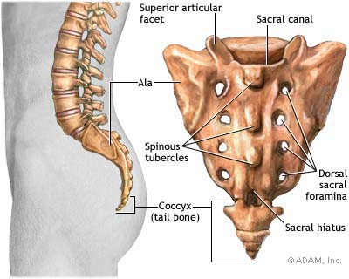
12. What is the evidence that humans descended from monkeys?
The human skeleton has a tail bone- the coccyx. This is presumed to be left over from the monkeys we descended from.

Slide 19
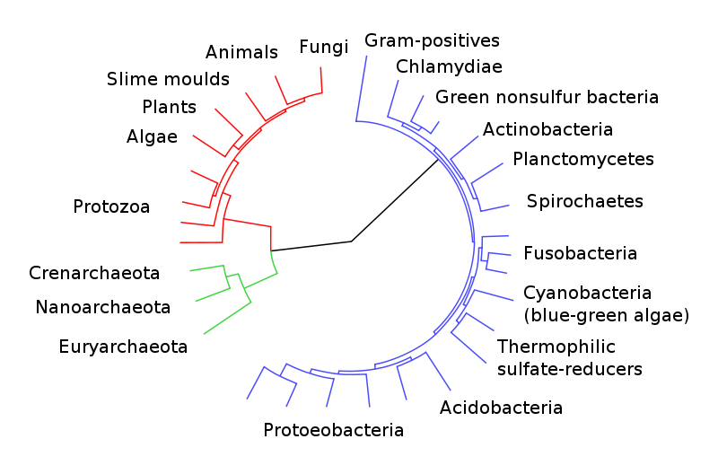
Eukaryotes are colored red, archaea green and bacteria blue
A highly resolved Tree Of Life, based on completely sequenced genomes. Ciccarelli, FD (2006). "Toward automatic reconstruction of a highly resolved tree of life." (Pubmed). Science 311(5765): 1283-7.

Slide 20
Homework
Read p. 235- 237 Answer questions 1-4 on p. 237
Note: Quiz on Natural Selection and Genetics this Friday, November 16th

Slide 21
Answers to homework p. 237
Which of these 2 statements applies to the theory of evolution?
Species evolve because young adults pass their knowledge on to their young.
Species evolve because new characteristics appear in individuals and because natural selection promotes the reproduction and survival of the species best adapted to their environment.

Slide 22
2) Some peppered moths have a light colour and others a dark colour. How does this moth species benefit from this colour variation?
Variation in the moth’s colour allow it survive in it’s environment by allowing it to go unnoticed by its predators.
Pale moths survive on birches whose trunks are light (country)
dark moths survive on birches who trunks are dark (near factories)

Slide 23
3) a. What is the difference between a chromosome and a gene?
A chromosome is a group of genes present in the nuclei of cells. Chromosomes contain all the genes required to produce a living organism
Genes determine the particular characteristics of an individual.
one set of genes determines hair colour, another eye colour, etc.

Slide 24
3b) What part of the cell contains our chromosomes and genes?
The cell’s nulceus.
4) Imagine that crossing a yellow pea plant with a green pea plant produced the following results: three-quarters of the young plants are yellow-pea plants and only a quarter are green pea-plants. What conclusions can you draw?
The genes determining yellowness are probably dominant compared to the genes determining greeness.

